Slide 1
Training Module 1.2
Introduction to Linked Data

Slide 2
This presentation has been created by PwC
Authors:
Michiel De Keyzer, Nikolaos Loutas, Christophe Colas and Stijn Goedertier
Presentation metadata
Disclaimer
The views expressed in this presentation are purely those of the authors and may not, in any circumstances, be interpreted as stating an official position of the European Commission.
The European Commission does not guarantee the accuracy of the information included in this presentation, nor does it accept any responsibility for any use thereof.
Reference herein to any specific products, specifications, process, or service by trade name, trademark, manufacturer, or otherwise, does not necessarily constitute or imply its endorsement, recommendation, or favouring by the European Commission.
All care has been taken by the author to ensure that s/he has obtained, where necessary, permission to use any parts of manuscripts including illustrations, maps, and graphs, on which intellectual property rights already exist from the titular holder(s) of such rights or from her/his or their legal representative.
Open Data Support is funded by the European Commission under SMART 2012/0107 ‘Lot 2: Provision of services for the Publication, Access and Reuse of Open Public Data across the European Union, through existing open data portals’(Contract No. 30-CE-0530965/00-17).

Slide 3
Learning objectives
By the end of this training module you should have an understanding of:
What is linked data;
What is open data;
What is the difference between linked and open data;
How to publish linked data (5-star schema);
The economic and social aspects of linked data.

Slide 4
Content
This module contains ...
An introduction to the linked data principles;
An introduction to linked data technologies;
An outline of the 5-star scheme for publishing linked data;
  An example of how tabular data can be published as linked data using Open Refine;
The expected benefits of linked data for governments;
An overview of linked data initiatives in Europe.

Slide 5
What is linked data?
Evolution from a document-based Web to a Web of interlinked data.

Slide 6
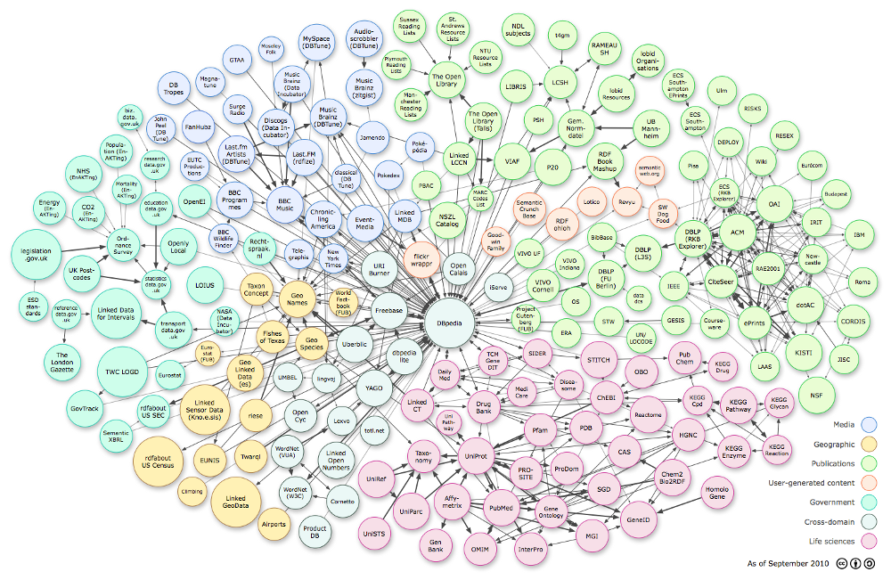
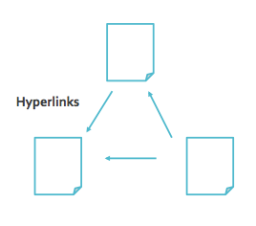
The Web is evolving from a “Web of linked documents” into a “Web of linked data”... (1/2)
Web of documents...
Web of linked data...

Slide 7
The Web is evolving from a “Web of linked documents” into a “Web of linked data”... (2/2)
  The Web started as a collection of documents published online – accessible at Web location identified by a URL.
  These documents often contain data about real-world resources which is mainly human-readable and cannot be understood by machines.
  The Web of Data is about enabling the access to this data, by making it available in machine-readable formats and connecting it using Uniform Resource Identifiers (URIs), thus enabling people and machines to collect the data, and put it together to do all kinds of things with it (permitted by the licence).
Machine-readable data (or metadata) is data in a format that can be interpreted by a computer.
2 types of machine-readable data:
  human-readable data that is marked up so that it can also be understood by computers, e.g. microformats, RDFa;
  data formats intended principally for computers, e.g. RDF, XML and JSON.
See also:
http://www.ted.com/talks/tim_berners_lee_on_the_next_web.html
http://linkeddatabook.com/editions/1.0/

Slide 8
Defining linked data...
“Linked data is a set of design principles for sharing machine-readable data on the Web for use by public administrations, business and citizens.”
EC ISA Case Study: How Linked Data is transforming eGovernment
The four design principles of Linked Data (by Tim Berners Lee):
Use Uniform Resource Identifiers (URIs) as names for things.
Use HTTP URIs so that people can look up those names.
When someone looks up a URI, provide useful information, using the standards (RDF*, SPARQL).
Include links to other URIs so that they can discover more things.
See also:
http://www.youtube.com/watch?v=4x_xzT5eF5Q
http://www.w3.org/DesignIssues/LinkedData.html http://www.youtube.com/watch?v=uju4wT9uBIA

Slide 9
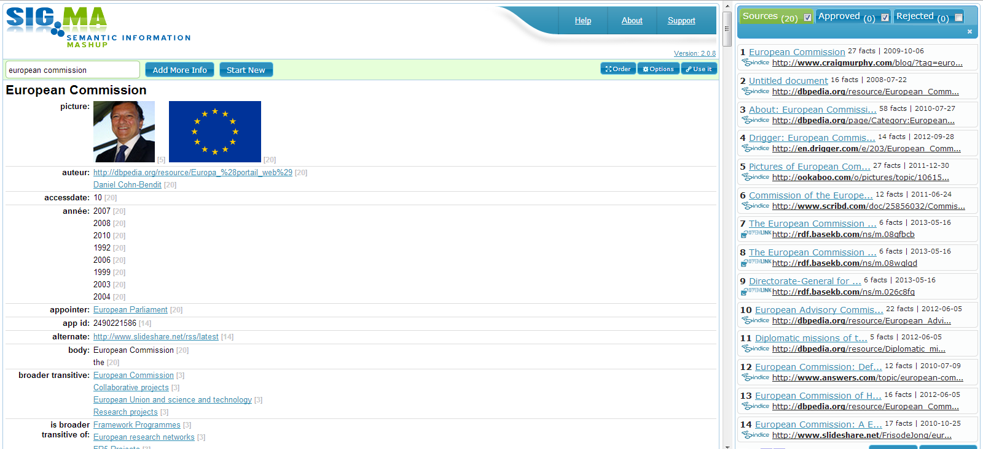
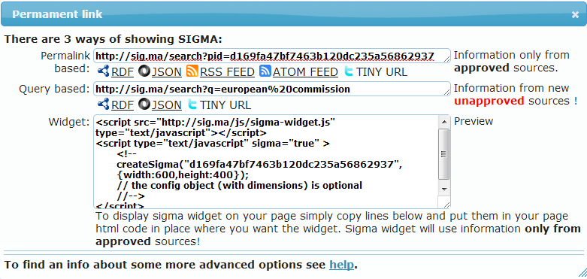
The four principles in practice...
3
1 & 2
4

Slide 10

Linked data vs. open data
“Open data is data that can be freely used, reused and redistributed by anyone – subject only, at most, to the requirement to attribute and sharealike.”
- OpenDefinition.org
Open data
Data can be published and be publicly available under an open licence without linking to other data sources.
Linked data
Data can be linked to URIs from other data sources, using open standards such as RDF without being publicly available under an open licence.
See also:
Cobden et al., A research agenda for Linked Closed Data
http://ceur-ws.org/Vol-782/CobdenEtAl_COLD2011.pdf

Slide 11
Linked data foundations
URIs for naming things, RDF for describing data and SPARQL for querying it.

Slide 12



Uniform Resource Identifier (URI)
“A Uniform Resource Identifier (URI) is a compact sequence of characters that identifies an abstract or physical resource.”
– ISA’s 10 Rules for Persistent URIs
A person, e.g. Albert Einstein
    http://dbpedia.org/resource/Albert_Einstein
A country, e.g. Belgium
    http://dbpedia.org/resource/Belgium
A world heritage site, e.g. the Acropolis of Athens
    http://dbpedia.org/resource/Acropolis_of_Athens
  A dataset, e.g. Fertility Indicators
    http://open-data.europa.eu/en/data/dataset/ 03YMULVqadXL7IO6JZiBkQ
BE
See also:
http://www.slideshare.net/OpenDataSupport/design-and-manage-persitent-uris

Slide 13
RDF & SPARQL
The Resource Description Framework (RDF ) is a syntax for representing data and resources in the Web
RDF breaks every piece of information down in triples:
Subject – a resource, which may be identified with a URI.
Predicate – a URI-identified reused specification of the relationship.
Object – a resource or literal to which the subject is related.
SPARQL is a standardised language for querying RDF data.
http://dbpedia.org/resource/Brussels is the capital of “Belgium”.
OR
http://dbpedia.org/resource/Brussels is the capital of http://dbpedia.org/resource/Belgium.
Subject
Predicate
Object
See also:
http://www.slideshare.net/OpenDataSupport/introduction-to-rdf-sparql

Slide 14
How to publish linked data?
Paving the way towards 5-star linked data

Slide 15
5 star-schema of Linked (Open) Data
★ | Make your stuff available on the Web (whatever format) under an open license.
★★ | Make it available as structured data (e.g., Excel instead of image scan of a table)
★★★ | Use non-proprietary formats (e.g., CSV instead of Excel)
★★★★ | Use URIs to denote things, so that people can point at your stuff
★★★★★ | Link your data to other data to provide context
optional

Slide 16
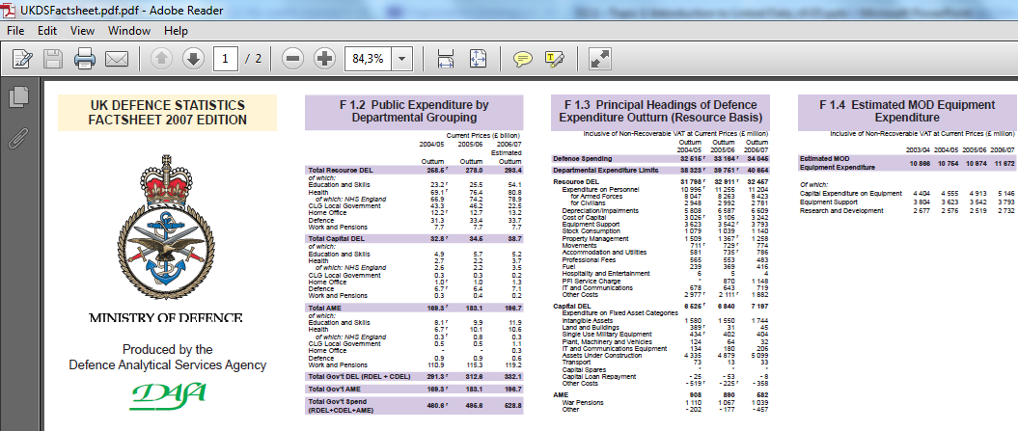

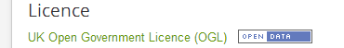
★ Make your stuff available on the Web under an open licence

Slide 17
Pros & cons of ★ open data
As a consumer... | As a publisher...
You can look at it. | It is simple to publish.
You can store it locally. | You do not have explain repeatedly to others that they can use your data.
You can enter the data into any other system.
You can change the data.
You can share the data with anyone.

Slide 18
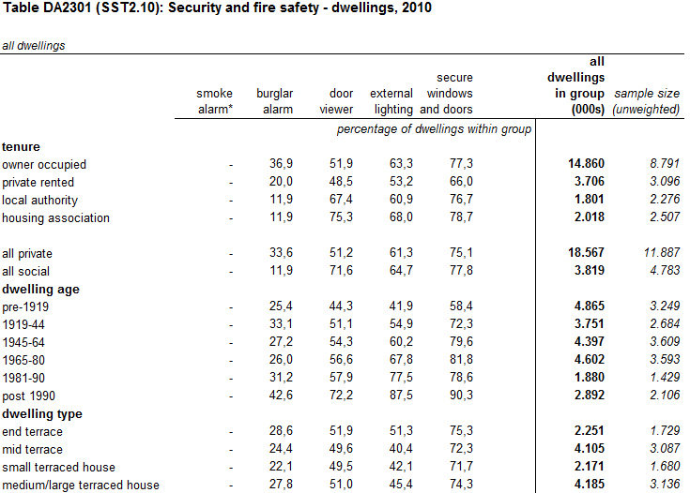
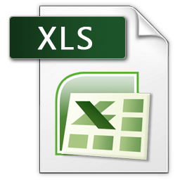
★ ★ Make it available as structured data

Slide 19
Pros & cons of ★ ★ open data
All the benefits of ★ open data; plus
As a consumer... | As a publisher...
You can directly process it with proprietary software to aggregate it, perform calculations, visualise it, etc. | It is still simple to publish.
You can export it into another (structured) format.

Slide 20
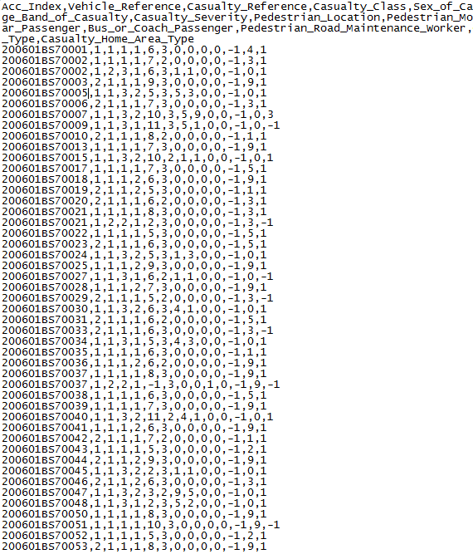

★ ★ ★ Use non-proprietary formats
Proprietary: Excel, Word, PDF...
Non-proprietary: XML, CSV, RDF, JSON, ODF...
Road safety- Accidents 2006:

Slide 21
Pros & cons of ★ ★ ★ open data
All the benefits of ★ ★ open data; plus
As a consumer... | As a publisher...
You can manipulate the data in any way you like, without being confined by the capabilities of any particular software. | It is still simple to publish.
 | - But, you do need converters or plug-ins to export the data from the proprietary format.

Slide 22
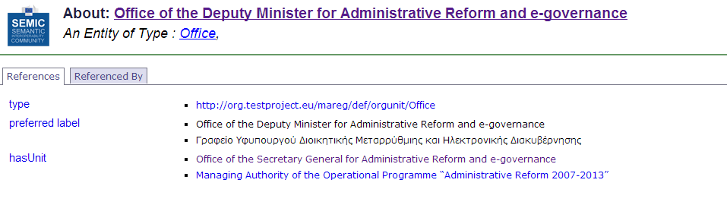
★ ★ ★ ★ Use URIs to denote things
For example, creating an URI for one of the units of the Greek Ministry of the Administrative Reform and e-Governance.
http://org.testproject.eu/id/office/office-of-the-deputy-minister-for-administrative-reform-and-e-governance
See also:
http://www.slideshare.net/OpenDataSupport/design-and-manage-persitent-uris

Slide 23
Pros & cons of ★ ★ ★ ★ open data
All the benefits of ★ ★ ★ open data; plus
As a consumer... | As a publisher...
You can link to it from any other place. | You have fine-granular control over the data items and can optimise their access.
You can bookmark it. | Other data publishers can now link into your data, promoting it to 5 star.
You can reuse parts of the data. | You will be able to reuse vocabularies, data and metadata, and URI design patterns instead of creating them from scratch.
You may be able to reuse existing tools and libraries.
You can combine the data safely with other data. | - But you typically need to invest some time in slicing and dicing your data.
- But understanding the technology requires effort and can have a steep learning curve.

Slide 24
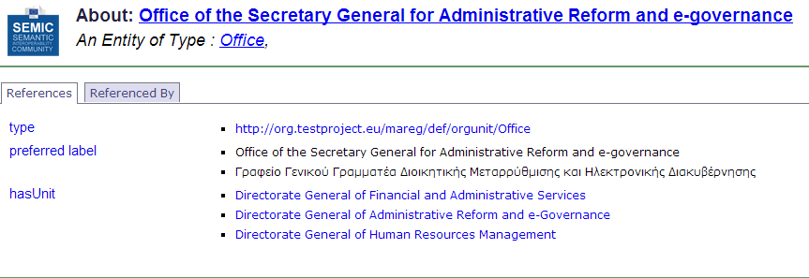
★ ★ ★ ★ ★ Link your data to other data to provide context

Slide 25
Pros & cons of ★ ★ ★ ★ ★ open data
All the benefits of ★ ★ ★ ★ open data; plus
As a consumer... | As a publisher...
You can discover more (related) data while consuming the data. | You make your data discoverable.
You can directly learn about the data schema. | You increase the context, expressivity, quality and value of your data (and consequently you give visibility to your organisation).
You can combine data from different source, be innovative, gain new knowledge, be an entrepreneur... | - This requires an investment in time, money, technology and competencies/ skills.
- But, you now have to deal with broken data links. Not all publishers/data sources will be reliable.

Slide 26
Example
Using Open Refine for RDF to publish tabular data as Linked Data.

Slide 27

What is Open Refine RDF extension
Open Refine RDF extension, allows you to easily import data in different formats such as :
    CSV;
    Excel(.xls and .xlsx);
    JSON;
    XML; and
    RDF/XML.
And then determine the intended structure of an RDF dataset, by drawing a template graph.
See also:
LOD 2 Webinar – Open Refine http://www.youtube.com/watch?v=4Ve93C238gI

Slide 28
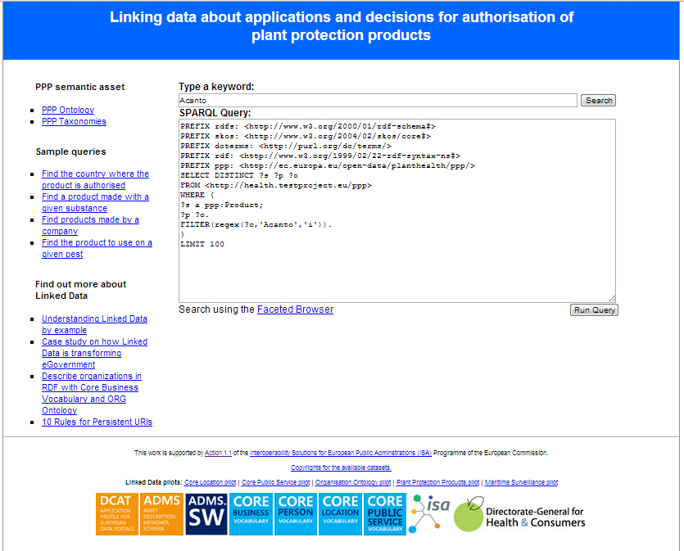
Case study: Linking data about plant protection products
We will show how a dataset of the Greek Ministry of Rural Development and Food was described using an ontology developed by DG Health and Consumers and was then published as Linked Data.
The dataset was in CSV format.
http://health.testproject.eu/PPP/
See also:
http://joinup.ec.europa.eu/asset/core_business/document/linking-data-about-applications-and-decisions-authorisation-ppp

Slide 29
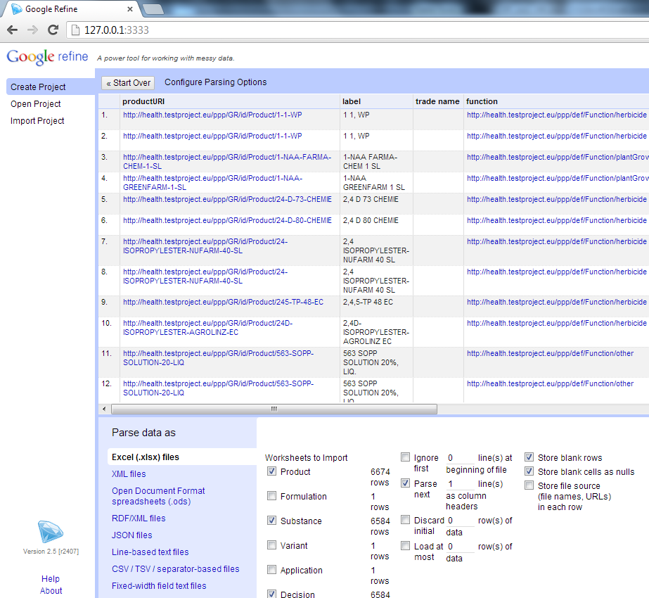
Creating the project in Open Refine
  Make sure that Open Refine and the RDF extension are installed on your machine.
  Launch Open Refine.
  Upload the spreadsheet and selected the sheets that you want.
  Confirm the creation of the project.

Slide 30
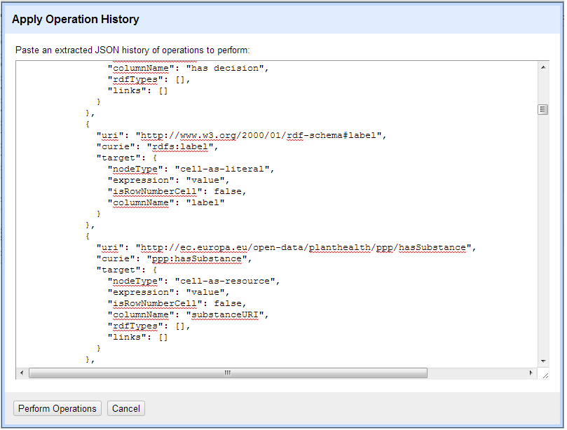
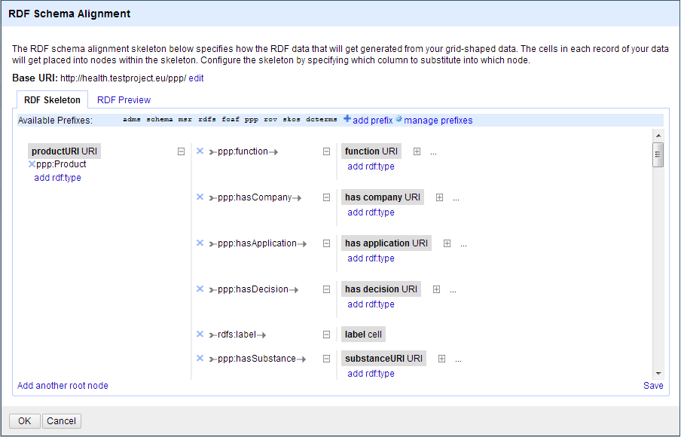
Mapping the raw data to the ontology
You can map the data to the ontology using a simple graphical interface to create or edit an existing RDF skeleton.
You can set the base URI for the data.
Graphical interface to edit an RDF skeleton
Graphical interface to copy/paste an existing RDF skeleton

Slide 31
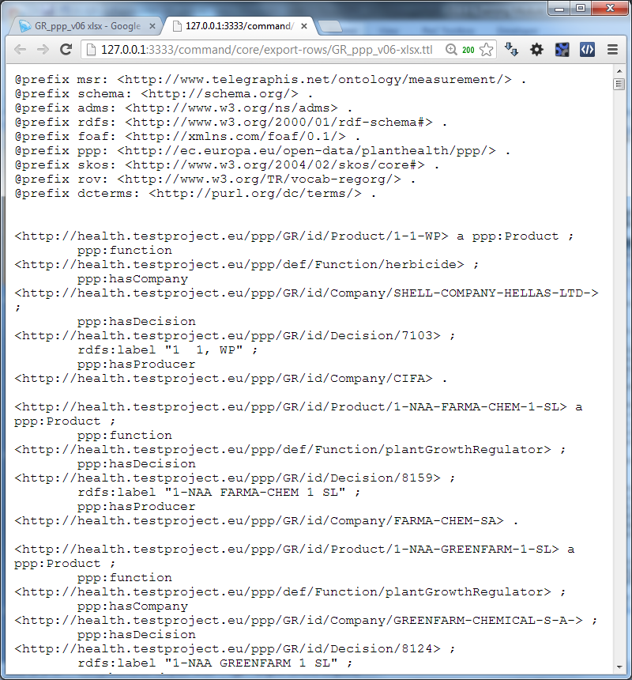
Exporting the data in RDF – Linked Data
You can now export your data in:
RDF/XML; or
Turtle
Export of the data in Turtle

Slide 32
Towards Linked (Open) Government Data
How can governments make use of linked data?

Slide 33



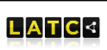


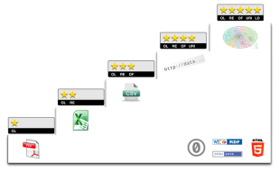

Key milestones for linked government data
The large research initiative on Linked Open Data (LOD2) and the LOD Around The Clock (LATC) project are launched under FP7
http://lod2.eu/
http://latc-project.eu/
ISA Member State representatives endorse key Linked Government Data specifications
http://joinup.ec.europa.eu/news/isa-member-state-representatives-endorse-key-specifications-e-government-interoperability
SPARQL, the query language for RDF, published as W3C recommendation
http://www.w3.org/TR/rdf-sparql-query/
RDF published as W3C recommendation
http://www.w3.org/RDF
2004
2006
2008
2009
2010
2011
2012
Tim Berners-Lee publishes the 4 Linked Data principles
http://www.w3.org/DesignIssues/LinkedData.html
http://5stardata.info/
The UK Government released data.gov.uk. Pioneer in linked government data they contributed to set the example world-wide.
W3C establishes the Government Linked Data (GLD) Working Group
http://www.w3.org/2011/gld

Slide 34
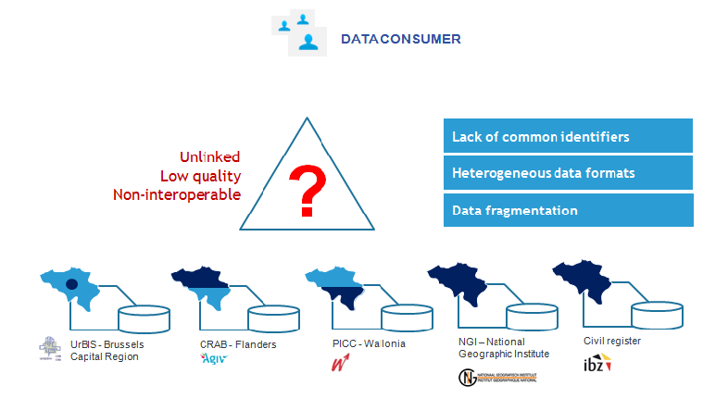
Linked data can help you publish structured data and integrate data from different sources
For example in Belgium, 6 organisations maintain isolated address registers

Slide 35
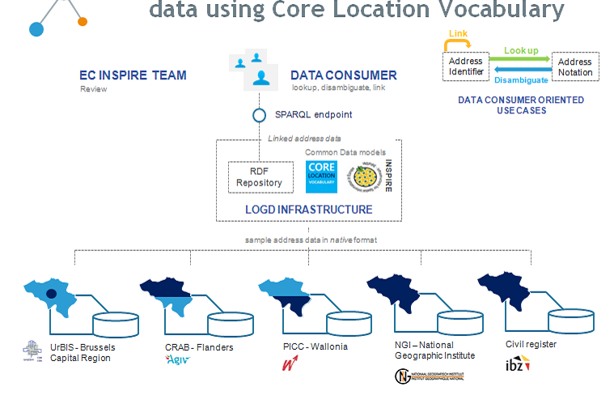
Linked data enables you to build a common integrated view of a real-world object
Building a common view on address data in Belgium
See also:
https://joinup.ec.europa.eu/asset/core_location/document/core-location-pilot-interconnecting-belgian-address-data
http://location.testproject.eu

Slide 36
Benefits of using linked data
  Allows for flexible integration of datasets from different sources, without needing the data to be moved.
  Fosters the reuse of information from reference/authoritative sources.
  Caters for assigning common identifiers in the form of HTTP URIs to things (e.g. people, products, business, locations...).
  Provides context to data – richer and more expressive data.
    The use of standard Web interfaces (such as HTTP and SPARQL) can simplify the use of data for machines.

Slide 37
Considerations for publishing Linked Data
  Linked Data is high-quality data. Considerable data cleansing and curation is required.
  Managing the data lifecycle is a challenging task. Mechanisms for handling updates and deletions in the data should be devised.
  The tools and software supporting linked data solutions are still not at production level/quality.
  A central authority should take the responsibility of publishing and maintaining persistent HTTP URIs for data resources. Existing identifiers should be reused to the extent possible, especially the ones coming from reference data sources, such as company registers.
  Data is currently available under different licences and in most cases no licence actually exists. This hampers data reuse and integration. Possible licensing options for data and description metadata should be explored. The use of open licence, e.g. a public domain licence – CC0, is recommended, particularly for the metadata.
  Alternative business model for publishing linked data should be further explored. The costs and benefits of the different alternatives need to identified, before governments can decide on the adoption of the linked data technological paradigm.

Slide 38
Linked data initiatives in Europe
Some examples on supra-national, national, regional and private initiatives in the area of linked (open) data across Europe.

Slide 39
Member State initiatives – some examples
DE – Bibliotheksverbund Bayern
Linked data from 180 academic libraries in Bavaria, Berlin and Brandenburg.
IT – Agenzia per l’Italia digitiale
Three datasets published as linked data: the Index of Public Administration, the SPC contracts for web services and conduction systems and the Classifications for the data in Public Administration.
NL – Building and address register
The Dutch Address and Buildings base register published as linked data.
UK – Ordnance Survey
Three OS Open Data products published as linked data: the 1:50 000 Scale Gazetteer, Code-Point Open and the administrative geography taken from Boundary Line.
UK – Companies House
Publishing basic company details as linked data using a simple URI for each company in their database.

Slide 40














Linked Government Data & Metadata initiatives funded by the European Commission
Directive 2003/98/EC of the European Parliament and of the Council of 17 November 2003 on the reuse of public sector information
REVISED

Slide 41
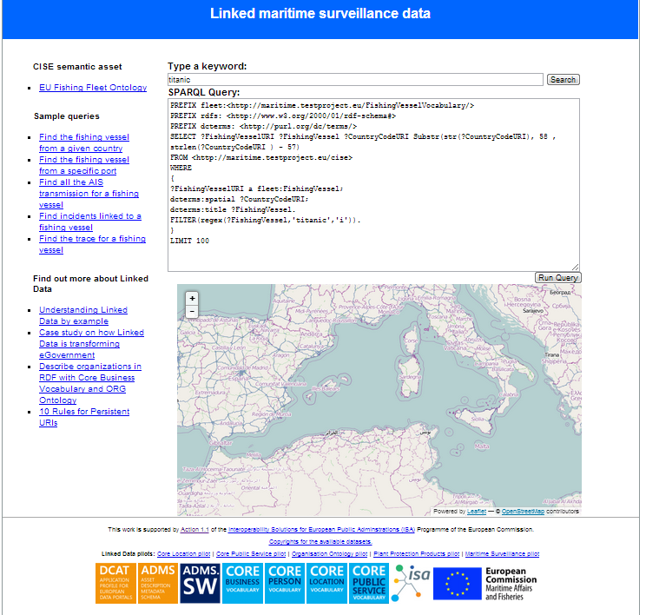
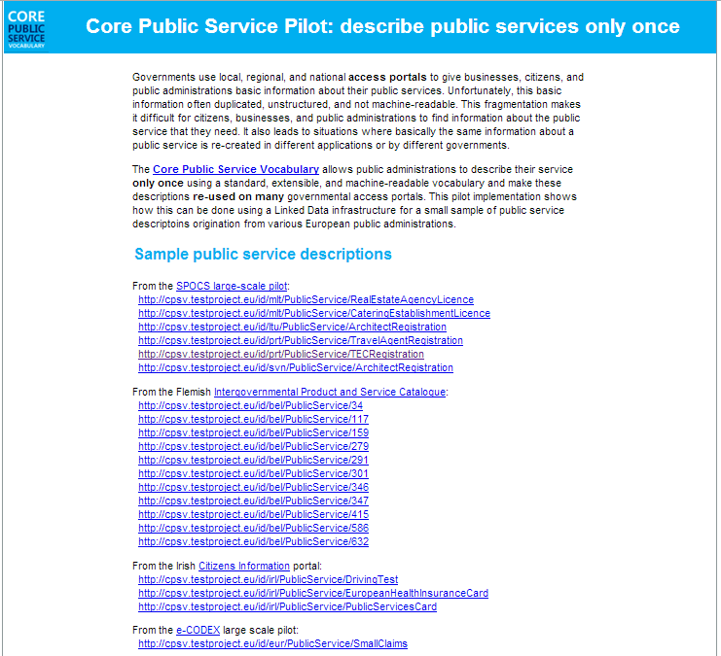
The Linked Government Data Pilots of ISA
http://health.testproject.eu/PPP/
http://maritime.testproject.eu/CISE/
http://cpsv.testproject.eu/CPSV/

Slide 42
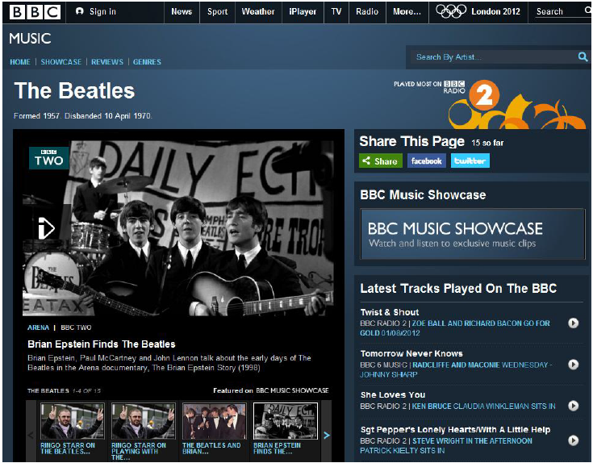
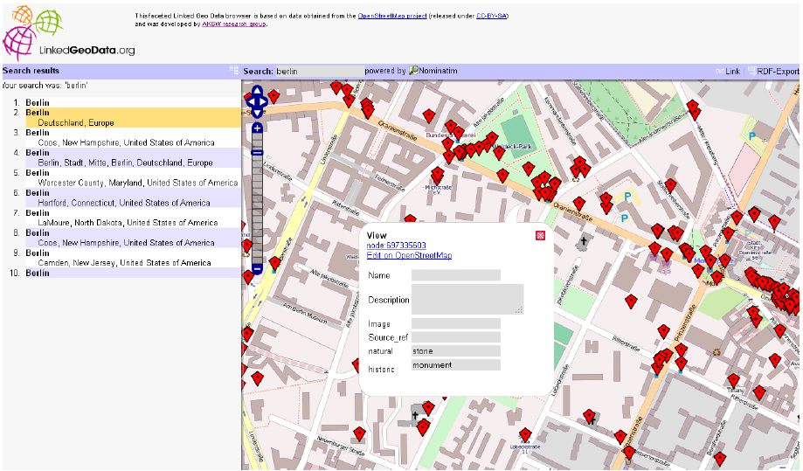
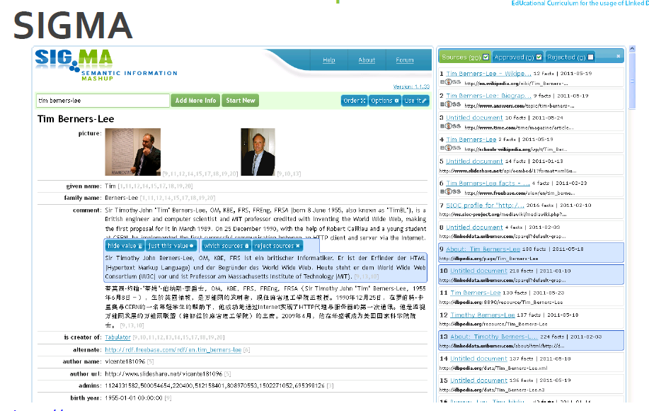
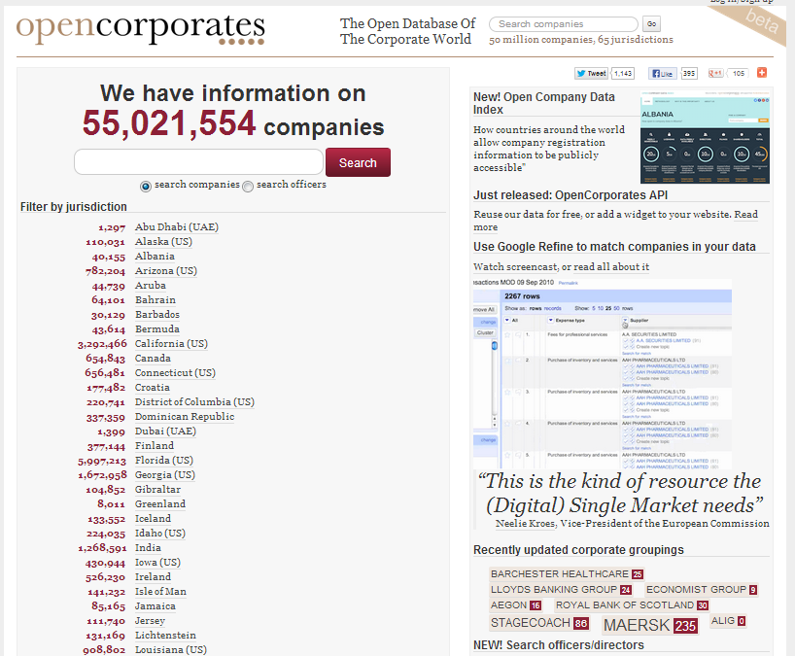
Non-governmental applications

Slide 43
Conclusions
  Linked data is a set of design principles for sharing machine-readable data on the Web.
Linked data and open data are not the same.
URIs, RDF and SPARQL form the foundational layer for Linked data.
Linked data offers a number of advantages for:
    Data integration with small impact on legacy systems;
    Enables for semantic interoperability;
    Enables creativity and innovation through context and knowledge-creation.

Slide 44

Group questions
  Is there supply and demand for (Linked) Open Government Data in your country?
  What are, in your opinion, the expected benefits and pitfalls of Linked Data?
  Are there any Linked (Open) Data initiatives in your country? If so, how many stars would you give them?
http://www.visualpharm.com
http://www.visualpharm.com
http://www.visualpharm.com

Slide 45
Thank you!
...and now YOUR questions?

Slide 46
References
Slide 6:
  EUCLID. Course 1: Introduction and Application Scenarios. http://www.euclid-project.eu/modules/course1
  Linking Open Data cloud diagram, by Richard Cyganiak and Anja Jentzsch. http://lod-cloud.net/
Slides 8:
  ISA Programme. Case study on how Linked Data is transforming eGovernment. https://joinup.ec.europa.eu/community/semic/document/case-study-how-linked-data-transforming-egovernment
  Tim Berners-Lee. Linked Data. http://www.w3.org/DesignIssues/LinkedData.html
Slide 9:
http://sig.ma/search?q=european+commission
Slide 10:
  The Open Knowledge Foundation. Open Data – An Introduction. http://okfn.org/opendata/
Slide 12:
  ISA Programme. D7.1.3 - Study on persistent URIs, with identification of best practices and recommendations on the topic for the MSs and the EC. https://joinup.ec.europa.eu/sites/default/files/D7.1.3%20-%20Study%20on%20persistent%20URIs.pdf
  UK Gov. Designing URI sets of the UK public sector, https://www.gov.uk/government/publications/designing-uri-sets-for-the-uk-public-sector
Slides 15-25:
5 ★ Open Data. http://5stardata.info/
Slide 16:
  Data.gov.uk. UK Defence Statistics Factsheet. http://data.gov.uk/dataset/uk_defence_statistics_factsheet
Slide 18:
Data.gov.uk. Housing stock. http://data.gov.uk/dataset/uk-housing-stock
Slide 20:
  Data.gov.uk. Road Safety Data. http://data.gov.uk/dataset/road-accidents-safety-data
Slide 22&24:
  ISA Organization Ontology pilot - Linking public sector's organisational data, https://joinup.ec.europa.eu/asset/core_business/document/organization-ontology-pilot-linking-public-sectors-organisational-data
  http://org.testproject.eu/MAREG/
Slide 34 & 35:
  ISA Programme. Core Location Pilot - Interconnecting Belgian Address Data. https://joinup.ec.europa.eu/asset/core_location/document/core-location-pilot-interconnecting-belgian-address-data
Slides 27-31:
Open Refine: https://github.com/OpenRefine
RDF Extension: http://refine.deri.ie/
  ISA Programme, Linking data about applications and decisions for authorisation of PPP, http://joinup.ec.europa.eu/asset/core_business/document/linking-data-about-applications-and-decisions-authorisation-ppp
Slide 39:
Bibliotheksverbund Bayern, http://lod.b3kat.de/doc
Agenzia per l’Italia Digitale, http://spcdata.digitpa.gov.it/data.html
NL – Building and address register, http://lod.Geodan.nl
UK Ordnance Survey, http://data.ordnancesurvey.co.uk/
UK Companies House, http://companieshouse.gov.uk/

Slide 47



Further reading
Linked Open Data: The Essentials. Florian Bauer, Martin Kaltenböck.
http://www.semantic-web.at/LOD-TheEssentials.pdf
Linked Data: Evolving the Web into a Global Data Space. Tom Heath and Christian Bizer.
http://linkeddatabook.com/editions/1.0/
Linked Open Government Data. Li Ding Qualcomm, Vassilios Peristeras and Michael Hausenblas.
http://ieeexplore.ieee.org/stamp/stamp.jsp?tp=&arnumber=6237454
EUCLID - Course 1: Introduction and Application Scenarios
http://www.euclid-project.eu/modules/course1

Slide 48






Related projects and initiatives
LOD2 FP7 project, http://lod2.eu/
The Open Knowledge Foundation, http://okfn.org/
  W3C Semantic Web, http://www.w3.org/standards/semanticweb/
  EUCLID, http://projecteuclid.org/
  ISA Programme, http://ec.europa.eu/isa/
  W3C LOGD WG, http://www.w3.org/2011/gld/wiki/Main_Page
  LOD Around The Clock FP7 project, http://latc-project.eu/
  Data.gov.uk, http://data.gov.uk/linked-data

Slide 49





Be part of our team...
Find us on
Join us on
Open Data Support
http://www.slideshare.net/OpenDataSupport
Open Data Support
http://goo.gl/y9ZZI
http://www.opendatasupport.eu
Follow us
Contact us
@OpenDataSupport
    contact@opendatasupport.eu

